Slide 1
REST & Ajax
Frictionless Flow of Information
Notes:
For PostMan installation, see p205 – 1st edition p235 – 2nd edition

Slide 2
REST Web Services
REST = REpresentational State Transfer
REST is an architectural style consisting of a coordinated set of architectural constraints
First described in 2000 by Roy Fielding in his doctoral dissertation at UC Irvine
RESTful is typically used to refer to web services implementing a REST architecture
Alternative to other distributed-computing specifications such as SOAP
Simple HTTP client/server mechanism to exchange data
Everything – the UNIVERSE is available through a URI
Utilizes HTTP: GET/POST/PUT/DELETE operations

Slide 3
Architectural Constraints
Client–server
  Separation of concerns. A uniform interface separates clients from servers.
Stateless
  The client–server communication is further constrained by no client context being stored on the server between requests.
Cacheable
  Basic WWW principle: clients can cache responses.
Layered system
  A client cannot necessarily tell whether it is connected directly to the end server, or to an intermediary along the way.
Uniform interface
  Individual resources are identified in requests, i.e.,using URIs in web-based REST systems.

Slide 4
RESTful API HTTP methods
Resource | GET | PUT | POST | DELETE
Collection URI, such as http://example.com/resources | List the URIs and perhaps other details of the collection's members. | Replace the entire collection with another collection. | Create a new entry in the collection. The new entry's URI is assigned automatically and is usually returned by the operation. | Delete the entire collection.
Element URI, such as http://examples .com /resources/item17 | Retrieve a representation of the addressed member of the collection, expressed in an appropriate Internet media type. | Replace the addressed member of the collection, or if it doesn't exist, create it. | Not generally used. Treat the addressed member as a collection in its own right and create a new entry in it. | Delete the addressed member of the collection
A resource can be a singleton or a collection. For example, “customers” is a collection resource and “customer” is a singleton. We can identify “customers” collection resource using the URN “/customers”. We can identify a single “customer” resource using the URN “/customers/{customerId}”.
POST means "create new" as in "Here is the input for creating a user".
PUT means "insert, replace if already exists" as in "Here is the data for user 5".
PUT is Idempotent
Idempotent means that multiple calls with the same operation doesn’t change the representation
Notes:
It is still possible, that safe methods do change things on a server or resource, but this should not reflect in a different representation.
PUT being Idempotent does NOT mean SAFE as the first call can change the representation…as well as subsequent can change timestamp etc..
http://searchmicroservices.techtarget.com/definition/URN-Uniform-Resource-Name
Use PUT to UPDATE data ………….idenmpotent
- Use POST to ADD data
- Use DELETE to REMOVE data
Use GET to RETREIVE data
https://en.wikipedia.org/wiki/Representational_state_transfer
https://knpuniversity.com/screencast/rest/put-versus-post
http://zacharyvoase.com/2009/07/03/http-post-put-diff/
https://stormpath.com/blog/put-or-post
POST means "create new" as in "Here is the input for creating a customer, create it for me".
PUT means "insert, replace if already exists" as in "Here is the data for user 5".
You POST to example.com/users since you don't know the URL of the user yet, you want the server to create it.
You PUT to example.com/users/id since you want to replace/create a specific user.

Slide 5
Spring MVC REST-style Controller
Essentially means receive & send the content directly as the message body instead of structuring HTML pages.
We are NOT using HTML
We are using well-formed XML OR JSON
Spring support is based on the
  @RequestBody & @ResponseBody annotations
  @ResponseStatus(value = HttpStatus.NO_CONTENT)
    For deletes, creates, updates…

Slide 6
RequestBody & ResponseBody
@ResponseBody
  Spring framework uses the "Accept" header of the request to decide the media type to send to the client.
@RequestBody
  Spring framework will use the " Content-Type" header to determine the media type of the Request body received.
To get XML, MIME media type = "application/xml"
To get JSON, MIME media type = "application/json"

Slide 7
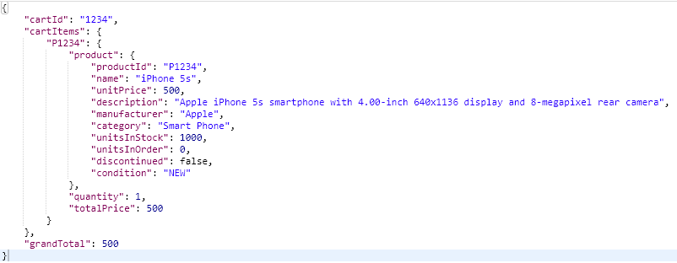
JSON (JavaScript Object Notation)

Slide 8
RESTful Web Service CartRestController
@Controller
public class CartRestController {
  @Autowired
  private CartService cartService;
  @RequestMapping(method = RequestMethod.POST)
  public @ResponseBody Cart create(@RequestBody Cart cart) {
  return cartService.create(cart);
  }
  @RequestMapping(value = "/{cartId}", method = RequestMethod.GET)
  public @ResponseBody Cart read(@PathVariable(value = "cartId") String cartId) {
  return cartService.read(cartId);
  }
  @RequestMapping(value = "/add/{productId}", method = RequestMethod.PUT)
  @ResponseStatus(value = HttpStatus.NO_CONTENT)
  public void addItem(@PathVariable String productId, HttpServletRequest request) {
  //Code omitted
  }
} See demo: webstore_rest
Notes:
Removed @RequestMapping(value = "rest/cart") on Class level

Slide 9
Main Point
REST is defined by architectural constraints. It is able to access information through the ubiquitous URI. Everything on the web is available through a URI.
Everything in creation is known through understanding and experience of the Unified Field of Consciousness

Slide 10
Web 2.0
WWW sites that emphasize user-generated content, usability, and interoperability.
Update selected regions of the page area without undergoing a full page reload.
Ajax and JavaScript frameworks:
  YUI Library - Dojo Toolkit - Moo Tools - jQuery
  Ext JS - Prototype JavaScript Framework
  Ember.js, React.js, AngularJS Backbone.js
Payload - typically formatted in XML or JSON
NOTE: we will use Spring MVC REST technology to create the Web 2.0 payload

Slide 11
AJAX
Asynchronous Javascript And XML
Web applications are able to make quick, incremental updates to the client without reloading the entire browser page
The use of XML is not required; JSON is often used instead ( AJAJ)
Examples :
  Validate values of form fields before saving
  Dynamically load dropdown values from database
  Load table data and paginations
  Live Search
Ajax - a broad group of Web technologies that communicates with a server in the background, without interfering with the current state of the page.

Slide 12
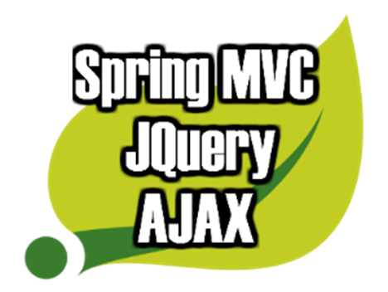
JQuery
SLOGAN: The Write Less, Do More, JavaScript Library.
Fast, small, and feature-rich JavaScript library.
HTML document traversal and manipulation, event handling, animation, and Ajax.

Slide 13
cart.js
RESTful services:
addToCart - Add Item
removeFromCart - Remove Item
showProduct - Show details of product in Cart

Slide 14
cart.js addToCart Function
addToCart = function(productId){
  $.ajax({
    url: '/webstore_rest/rest/cart/add/' + productId,
    type: 'PUT',
    dataType: "json",
    success: function(response){
    alert("Product Successfully added to the Cart!");
    },
    error: function(){
    alert('Error while request..');
    }
  });
}
Replace
var contextRoot = "/" + window.location.pathname.split('/')[1];
url: contextRoot + '/rest/cart/add/' + productId,

Slide 15
cart.jsp consumes cart.js example
Include js files
<script type="text/javascript" src="http://code.jquery.com/jquery-1.10.1.min.js"></script>
<script type="text/javascript" src="<spring:url value="/resource/js/cart.js"/>"></script>
  Invoke the Javascript add item function
<a href="#" class="btn btn-warning btn-large" onclick="addToCart('${product.productId}')"> Order Now </a>
  Invoke the Javascript remove item function
<a href="#" class="label label-danger"
onclick="removeFromCart('${item.value.product.productId}');">
Remove</a>
See demo: webstore_rest

Slide 16
RESTful input Validation
How does THAT work?
XML - Schema validation is generally not a good idea in a REST service.
A major goal of REST is to decouple client and server so that they can evolve separately.
What about JSON validation/consistency?
API producers have frequently developed their own JSON response formats in the absence of well-defined standards.
ALTERNATIVE OPTION: JSR-303 Bean Validation

Slide 17
category.jsp
<form id="categoryForm" method="post">
  <p>
  <label for="name"> Name : </label>
  <input type="text" name="name" id="name" value="" />
  </p>
  <p>
  <label for="description"> Description: </label>
  <input id="description" name="description" type="text" />
  </p>
  <input type="button" value="Add Category"
  onclick="categorySubmit();return false;" />
</form>

Slide 18
AJAJ Call
The JSON.stringify() method converts a JavaScript value/object to a JSON string EXAMPLE:
JSON.stringify({ x: 5, y: 6 }); yields '{"x":5,"y":6}'
function categorySubmit() {
  var dataToSend = JSON.stringify(serializeObject($('#categoryForm')));
  $.ajax({
    type : 'POST',
    url : contextRoot + '/addCategory',
    dataType : "json", // Accept header
    data : dataToSend,
    contentType : 'application/json', // Sends - Content-type
    success : function(response) {//Code here..},
    error : function(errorObject) {
      if (errorObject.responseJSON.errorType == "ValidationError") {
        //More Code here..
        var errorList = errorObject.responseJSON.errors;
        $.each(errorList, function(i, error) {
        $("#errors").append(error.message + '<br>');
        });
        $("#errors").append('</p>');
        $('#result').show();
      } else {
      alert(errorObject.responseJSON.errors(0)); // "non" Validation
      // Error
      }
    }
  });
}
serializeObject – custom function to take form data and structure it as a JSON object
e.g. [{ x: 5, y: 6 }]

Slide 19
RequestBody & ResponseBody
@Controller
public class CategoryRestController {
  @Autowired
  private CategoryService categoryService;
  @RequestMapping(value = "/addCategory", method = RequestMethod.POST)
  public @ResponseBody Category saveCategory(@Valid @RequestBody Category category) {
    categoryService.save(category);
    return category;
  }
}
if NO BindingResult bindingResult in Signature,
MethodArgumentNotValidException will be thrown if Category fails validation...

Slide 20
Form Validation Exception Handling
@ControllerAdvice
public class ExceptionController {
  @Autowired
  MessageSourceAccessor messageAccessor;
  @ExceptionHandler(MethodArgumentNotValidException.class)
  @ResponseStatus(HttpStatus.BAD_REQUEST)
  @ResponseBody
  public DomainErrors handleException(MethodArgumentNotValidException exception) {
    List<FieldError> fieldErrors = exception.getBindingResult().getFieldErrors();
    DomainErrors errors = new DomainErrors();
    errors.setErrorType("ValidationError");
    for (FieldError fieldError : fieldErrors) {
      DomainError error = new DomainError(messageAccessor.getMessage(fieldError));
      errors.addError(error);
    }
  return errors;
  }
}
See demo: BookRestValidation
<bean id="messageAccessor" class="org.springframework.context.support.MessageSourceAccessor">
<constructor-arg ref="messageSource"/>
</bean>

Slide 21
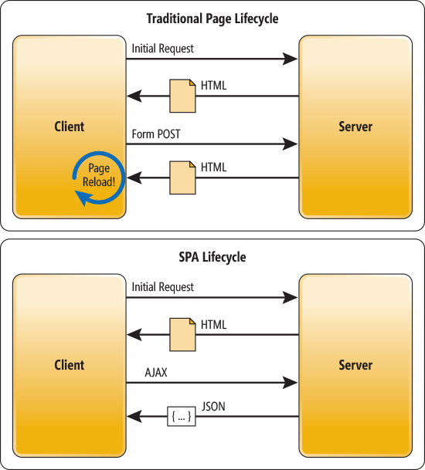
Spring MVC Rest Controller & SPA
Web application that fits on a single to provide a more fluid user experience.
All the “heavy lifting” presentation-wise is done on the client side, in JavaScript.
Server interaction with a SPA involves dynamic communication with the web server behind the scenes [RE: Ajax].
Spring RESTful Controller is a perfect fit for Server side support of SPA.
SPA
Spring MVC

Slide 22
Main Point
Ajax uses Javascript in a browser to access data or functionality residing on a server and then quickly and efficiently selectively update the browser.
Nature is maximally efficient.

